Slide 1
Data Structures
Hashing

Slide 2
Hashing
Balanced binary search trees support operations such as insert, delete and search in O(logn) time
But, if we need these operations in O(1), then Hashing provides a way

Slide 3
Hashing
Hashing is a technique used for storing and retrieving information as quickly as possible
Hash Tables are the data structure we use for implementing hashing

Slide 4

Scenario
Problem: Find no. of occurrences of each character in a given string. (for simplicity, assume that only letters are considered)

Slide 5
Scenario
Problem: Find no. of occurrences of each character in a given string.
Brute Force approach:
Given a string, for each character check whether that character is repeated or not
Inefficient approach, with O (n ^ 2) complexity

Slide 6
Scenario
Better approach:
Consider that the no. of possible characters is fixed i.e. 26
Create an array of size 26 and initialize it with all zeros
For each of the input characters go to the corresponding index and increment its count
Since it is an array, it takes constant time [ O(1) ] for reaching any position

Slide 7
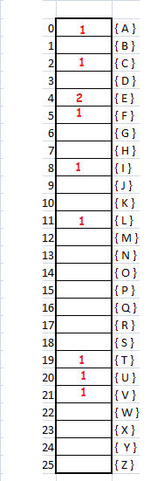
Better Approach
It takes just O(1) step to find no. of occurrences' for any given letter
This is the idea behind Hashing

Slide 8
Issue
Now let’s assume we had integers instead of letters
How do we solve this problem using the previous approach since possible values can be infinite (or very large)
Storing counters in arrays is not possible in this case

Slide 9
Hashing
The technique just proposed is the idea behind Hashing
Hash Tables are generalization of arrays in this technique

Slide 10
Components of Hashing
Hashing has four components:
Hash Table
Hash Functions
Collisions
Collision resolution techniques

Slide 11
Using Simple Arrays
Given a key k, we find the element whose key is k by just looking in the kth position of the array. This is called Direct Addressing
Direct addressing is practical only when we can afford to allocate an array with one position for every possible key

Slide 12
Hash Table
Normally, we do not have enough space to allocate a location for each possible key, so we need a mechanism to handle this case
In other words, if we have less locations and more possible keys, then simple array implementation is not enough

Slide 13
Hash Table
We use Hash Tables to overcome this issue
Hash table (or hash map) is a data structure that stores the keys and their associated values, and hash table uses a hash function to map keys to their associated values
In general, we use hash table when the no. of keys actually stored is small relative to the no. of possible keys

Slide 14
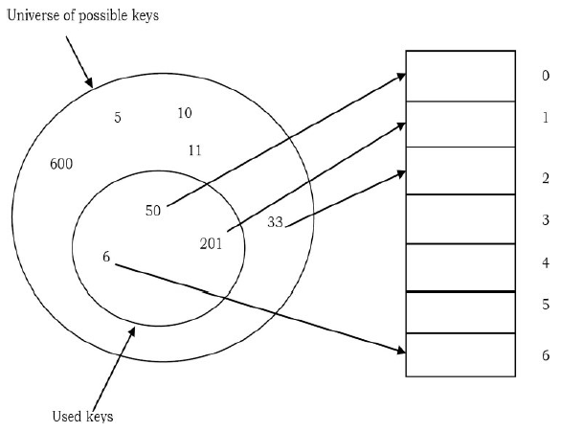
Hash Table: Example

Slide 15
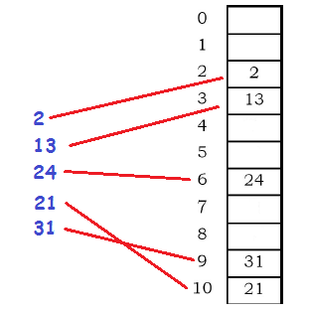
Hash Table: Another example

Slide 16
Point to ponder
How exactly are these keys mapped to an actual index?

Slide 17
Point to ponder
How exactly are these keys mapped to an actual index?
Answer: By using Hash Function

Slide 18
Hash Function
The Hash Function is used to transform the key into the index
Ideally, the hash function should map each possible key to a unique slot index, but it is difficult to achieve in practice

Slide 19
Hash Function
Hash functions can map keys to index but what happens if two keys map to the same index?
This situation is called Collision
There are ways to deal with collisions

Slide 20
Perfect Hash Function
Given a collection of elements, a hash function that maps each item into a unique slot is referred to as a Perfect Hash Function
If we know the elements and the collection will never change, then it is possible to construct a perfect hash function

Slide 21
Perfect Hash Function
One way to always have a perfect hash function is to increase the size of the hash table so that each possible value in the element range can be accommodated
Not always possible
Example: Storing 11-digit telephone numbers

Slide 22
Perfect Hash Function
Unfortunately, given an arbitrary collection of elements, there is no systematic way to construct a perfect hash function
Fortunately, we do not need hash functions to be perfect to gain performance efficiency

Slide 23
Characteristics of Good Hash Function
A good hash function should have the following characteristics:
Minimizes collision
Is computed quickly & easily
Distributes keys evenly in the hash table
Uses as much information from key as possible
Have a high load factor

Slide 24
Load Factor
The Load Factor of a non-empty hash table is the number of items stored in the table divided by the size of the table
Load Factor = no. of elements in hash table size of hash table
It is an important characteristic when we are expanding (rehashing) the hash table

Slide 25
Common Hash Functions
Some methods for key to index mapping are:
Division method (remainder method)
Division method with folding
Knuth division method
Multiplication method
among many more…

Slide 26
Division Method
To map a single integer key k to an index in a hash table of size m, the hash function h(k) is given as:
h(k) = k % m
Example: Map key 3 to an index in a hash table of size 9:
h(3) = 3 % 9 = 3

Slide 27
Division Method with Folding
In this method, we divide the elements into equal size pieces (the last piece may not be of equal size). Then add these pieces before finding the remainder

Slide 28
Division Method with Folding
Example: Mapping for the given 10-digit telephone number 436-555-4601 and hash table of size 11
Step 1:
43+65+55+46+01 = 210
Step 2:
h(210) = 210 % 11 = 1

Slide 29
Other Methods
Knuth Variant on Division:
h(k) = k(k+3) mod m
Multiplication Method:
s = k * A x = fractional part of s h(k) = floor( m * x )
where A is some arbitrary real value

Slide 30
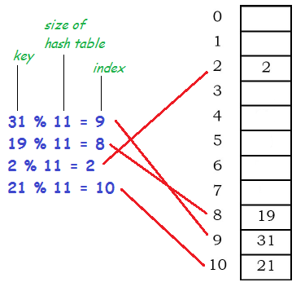
Example: Division Method

Slide 31
Collision
Collision is the condition where two records are stored in the same location
In hashing, collision occurs when hash function maps multiple keys map to the same index

Slide 32
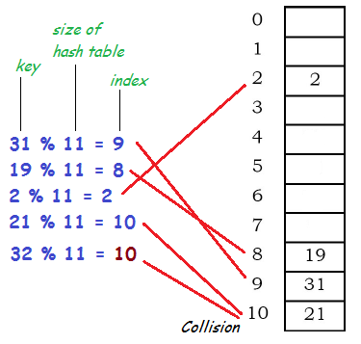
Example

Slide 33
Collision Resolution Techniques
The process of finding an alternate location is called collision resolution
The most popular techniques are direct chaining and open addressing (closed hashing)

Slide 34
Collision Resolution Techniques
Open Addressing
Linear Probing
Quadratic Probing
Double Hashing
Direct Chaining
Separate Chaining

Slide 35
Linear Probing
In linear probing, we search the hash table sequentially, starting from the original hash location
If a location is occupied, we check the next location. We wrap around from the last table location to the first table location if necessary

Slide 36
Linear Probing
Next Probe = (n + 1) % tablesize
where n is the originally generated index
It is easier
But suffers from the problem of clustering

Slide 37
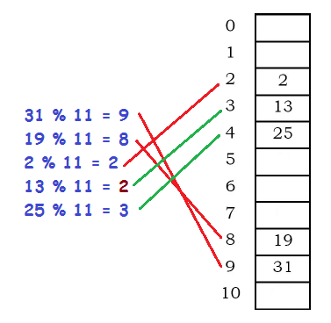
Linear Probing

Slide 38
Quadratic Probing
In Quadratic Probing, the interval between probes increases proportionally to the hash value (the interval thus increasing linearly, and the indices are described by a quadratic function)
If a location is occupied, we check the locations i + 1² , i +2², i + 3², i + 4²... We wrap around from the last table location to the first, if necessary

Slide 39
Quadratic Probing
Next Probe = (n + k²) % tablesize
where n is the originally generated index
It reduces clustering
However, still does not guarantee that no clustering occurs

Slide 40
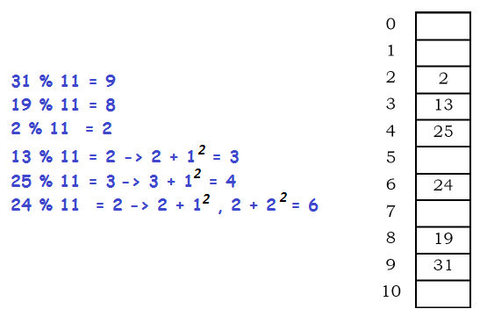
Quadratic Probing

Slide 41
Double Hashing
In Double Hashing, the increments for the probing sequence are computed by using a second hash function h2(k) where:
h2(key) ≠ 0 and h2 ≠ h1
We first probe the location h1(key). If the location is occupied, we probe the location as: [h1(key) + 1 * h2(key)] % M [h1(key) + 2 * h2(key)] % M [h1(key) + 3* h2(key)] % M … and so on
Much less clustering

Slide 42
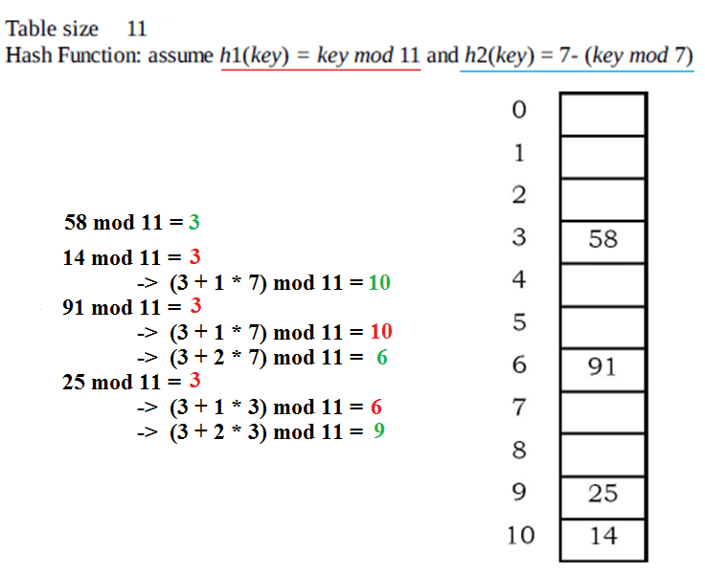
Double Hashing

Slide 43
Separate Chaining
When two or more records hash to the same location, these records are constituted into a singly-linked list called a chain
Easy to implement
Uses extra memory with long chains producing up to O(n) probing time

Slide 44
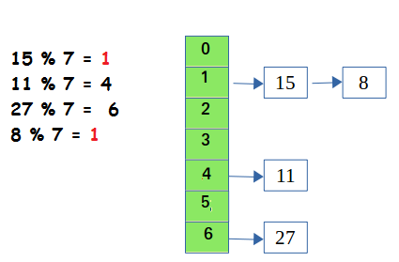
Separate Chaining

Slide 45
Rehashing
If the hash table becomes close to full or exceeds the threshold Load Factor, the search time grows and performance starts to deteriorate
Rehashing: Building a second table twice as large as the original and rehash there all the keys of the original table

Slide 46
Rehashing
Rehashing is done because whenever key value pairs are inserted into the map, the load factor increases, which implies that the time complexity also increases
Rehashing itself is expensive operation but once done, the new hash table will have good performance

Slide 47
Tombstones: For Probing/Insertion
The tombstone indicates that a record once occupied the slot but does so no longer
If a tombstone is encountered when searching along a probe sequence, the search procedure continues with the search
When a tombstone is encountered during insertion, that slot can be used to store the new record

Slide 48
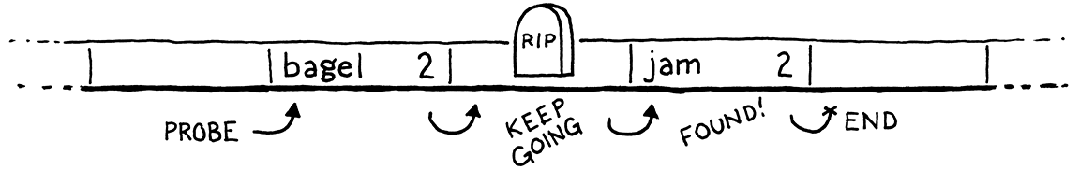
Tombstones: For Probing/Insertion

Slide 49
Static vs Dynamic Hashing
In static hashing, the data buckets are kept fixed and given in advance
In dynamic hashing, the data buckets can be added or removed on-demand

Slide 50
Examples
SHA1
MD5
among many more…

Slide 51
When NOT to use Hashing
Problems where ordering of data is important
Problems having dynamic nature of data
Problems in which there are several non-unique keys

